Slide 1
OASIS
Unit Enrolment Guide

Slide 2
Curtin Dubai Foundation Program
Streams available at Curtin Dubai campus
Business
Psychology
Engineering
Information technology
Design

Slide 3
Curtin Dubai Foundation Program
Single Trimester
Total Credits – 100
Business – 4 units
Psychology – 4 units
Engineering – 4 units
Information technology – 3 units
2 Trimesters
Total Credits – 200
Business - 8 units
Psychology - 8 units
Engineering - 7 units
Information technology - 7 units

Slide 4
CDFP Course Structure
Psychology
Business & Media
Engineering
Information Technology
2 Trimesters
Critical Thinking, Research, and Writing Computer Productivity Mathematical Foundations 1 Introduction to Management
Advanced Critical Thinking, Research, and Writing Introduction to Psychology Human Biology Introduction to Project Management
2 Trimesters
Critical Thinking, Research, and Writing Computer Productivity Mathematical Foundations Introduction to Management
Advanced Critical Thinking, Research, and Writing Introduction to Marketing Introduction to Accounting Introduction to Project Management
2 Trimesters
Critical Thinking, Research, and Writing Introduction to Programming Intensive Mathematics Foundations
Advanced Critical Thinking, Research and Writing Introduction to Chemistry Introduction to Physics Mathematical Foundations III
2 Trimesters
Critical Thinking, Research, and Writing Computer Productivity Intensive Mathematics Foundations
Advanced Critical Thinking, Research and Writing Introduction to Project Management Introduction to Programming Mathematical Foundations III
Single Trimester
Advanced Critical Thinking, Research, and Writing Mathematical Foundations Introduction to Psychology Human Biology
Single Trimester
Advanced Critical Thinking, Research, and Writing Mathematical Foundations Introduction to Management Introduction to Marketing
Single Trimester
Advanced Critical Thinking, Research and Writing Introduction to Chemistry Introduction to Physics Mathematical Foundations III
Single Trimester
Advanced Critical Thinking, Research and Writing Introduction to Programming Intensive Mathematics Foundations

Slide 5
CDFP Course Structure
Design
2 Trimesters
Critical Thinking, Research, and Writing Computer Productivity Mathematical Foundations 1 Introduction to Management
Advanced Critical Thinking, Research, and Writing Introduction to Marketing Introduction to Design Thinking Introduction to Project Management
Single Trimester
Advanced Critical Thinking, Research, and Writing Introduction to Marketing Mathematical Foundations 1 Introduction to Management

Slide 6
Important Notes
Core units – Important units which are part of your program and should be completed when available
Prerequisites – Units to be completed first before taking a higher level unit. This can be checked on the handbook http://handbook.curtin.edu.au
September trimester – It is important as there maybe units which are core and prerequisites for future units.

Slide 7
Academic Calendar Dates
Study Period | Trimester 3
Start Date | Monday,2 September 2024
Last Enrolment via eStudent | Saturday, 7 September 2024
Tuition Fee Payment Due Date - check with Fees | Monday, 9 September 2024
Teaching Census | Friday,27 September 2024
Last Withdrawal via eStudent | Friday, 1 November 2024
End Date | Friday, 6 December 2024
Last Date Results Entry | Tuesday, 17 December 2024
Results Publication | Thursday, 19 December 2024
Teaching Census: You can withdraw without being charged for the unit
Last Withdrawal: You will be charged full tuition fees for the unit and a grade of WD will appear on your transcript.

Slide 8

Go to Curtin Dubai’s homepage.
Click on OASIS Login

Slide 9
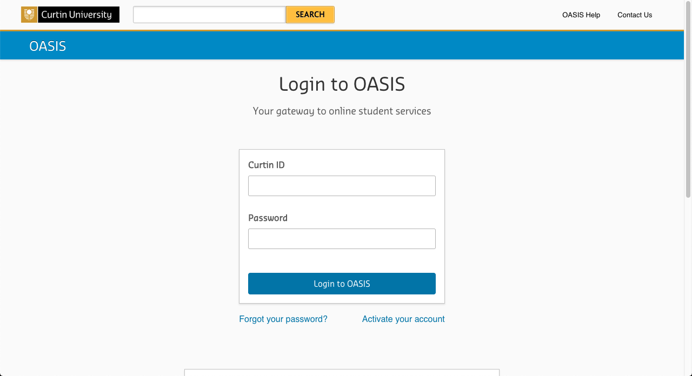
Log in to OASIS.
Available on offer letter

Slide 10
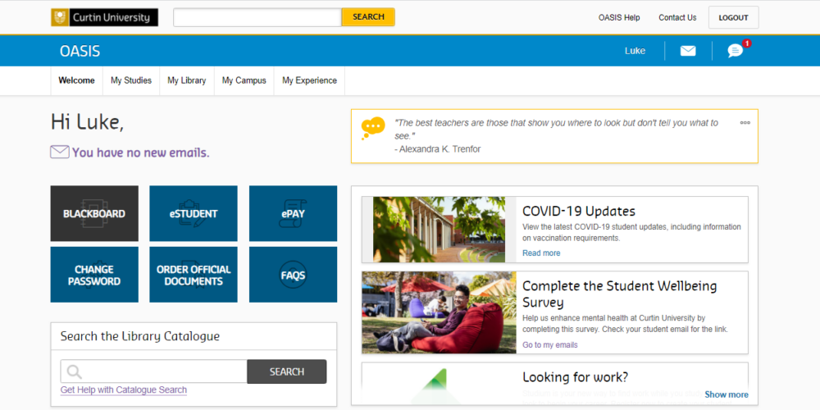
Welcome Page
Always check Official Communication Channel for important alerts

Slide 11
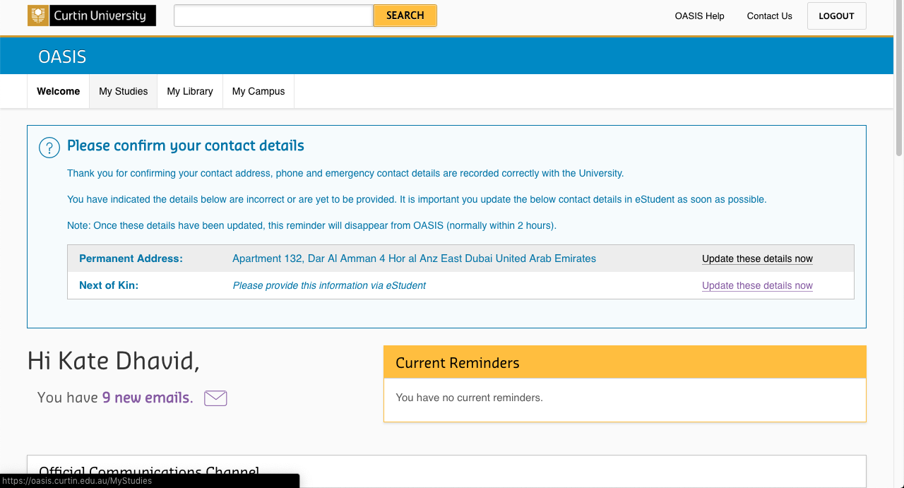
Click on the ‘My Studies’ tab

Slide 12
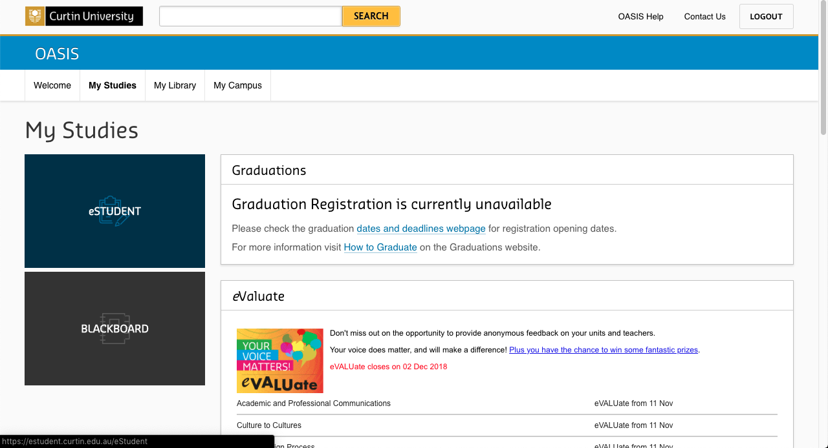
Click on ‘eStudent’

Slide 13
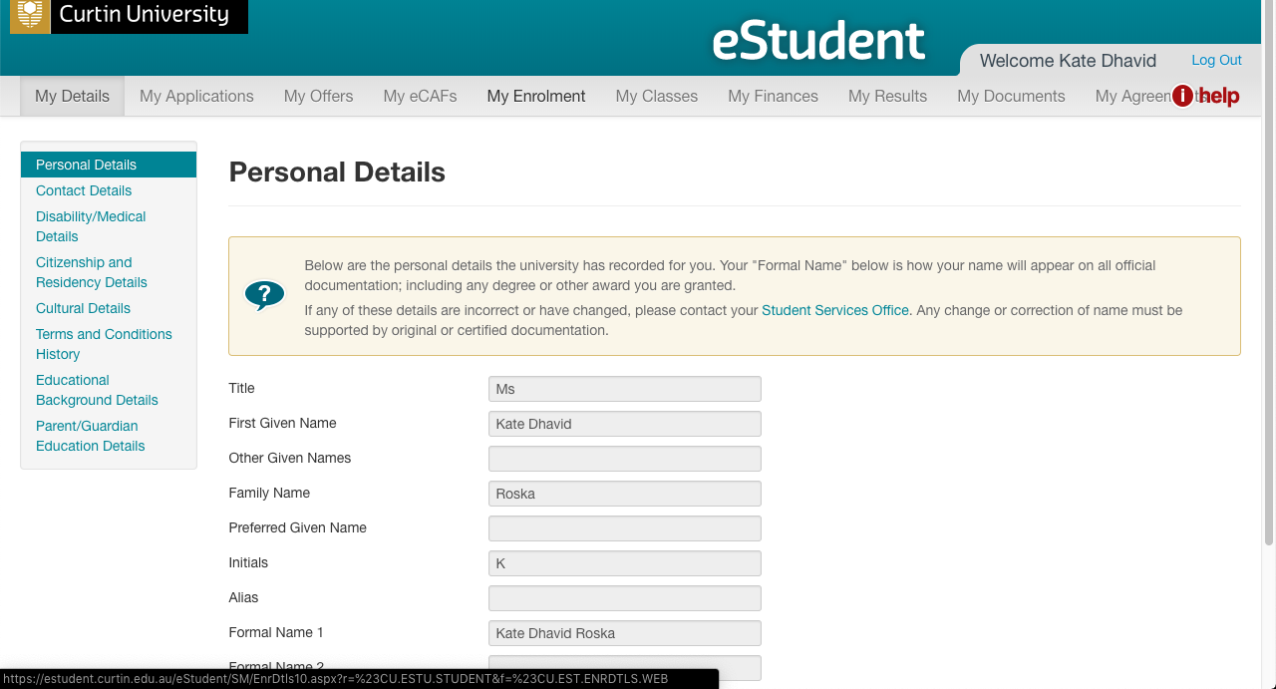
Note: A separate window for eStudent will pop up.
Click on the
‘My Enrolment’ tab.

Slide 14
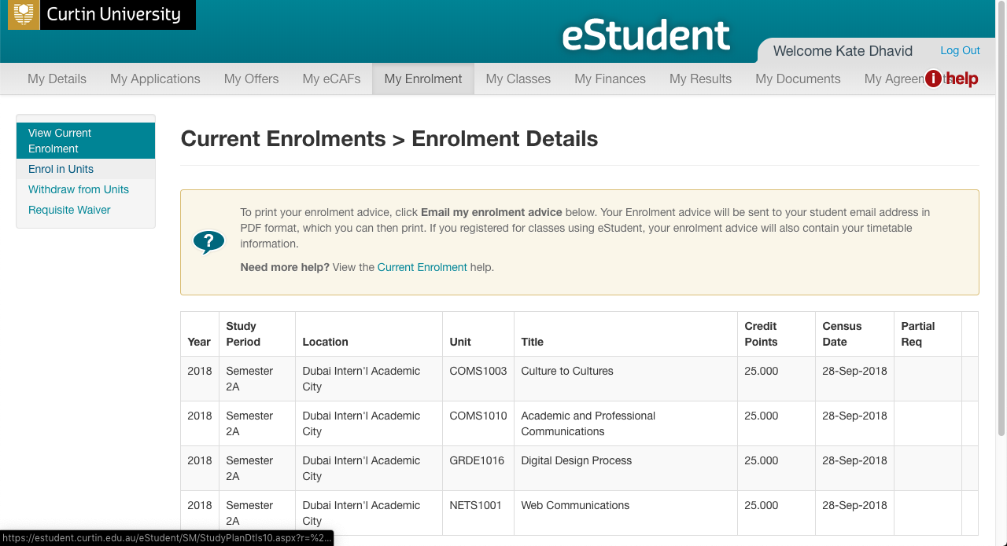
Click on
‘Enrol in Units’

Slide 15
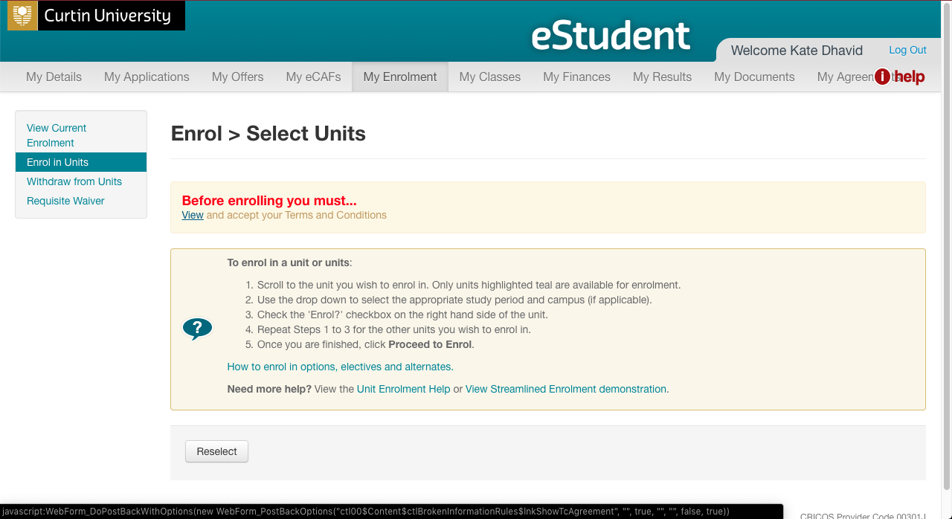
Warning message will appear for first-time users.
Click on ‘View’ to view the Institution Terms and Conditions’

Slide 16
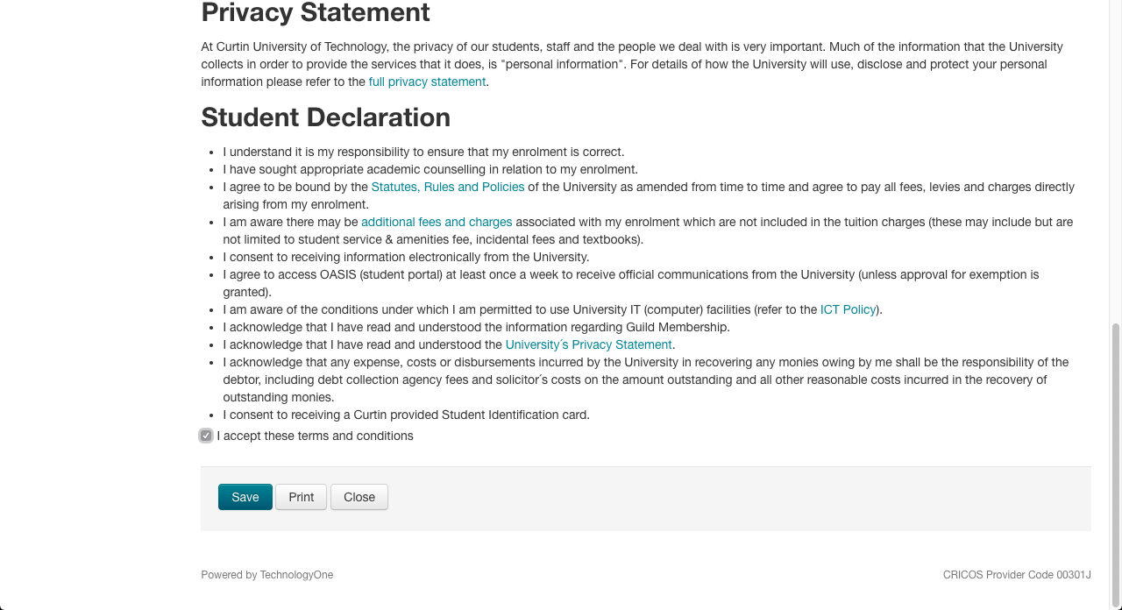
Institution Terms and Conditions
Please read and check ‘I accept these terms and conditions’.
Then click on ‘Save’.

Slide 17
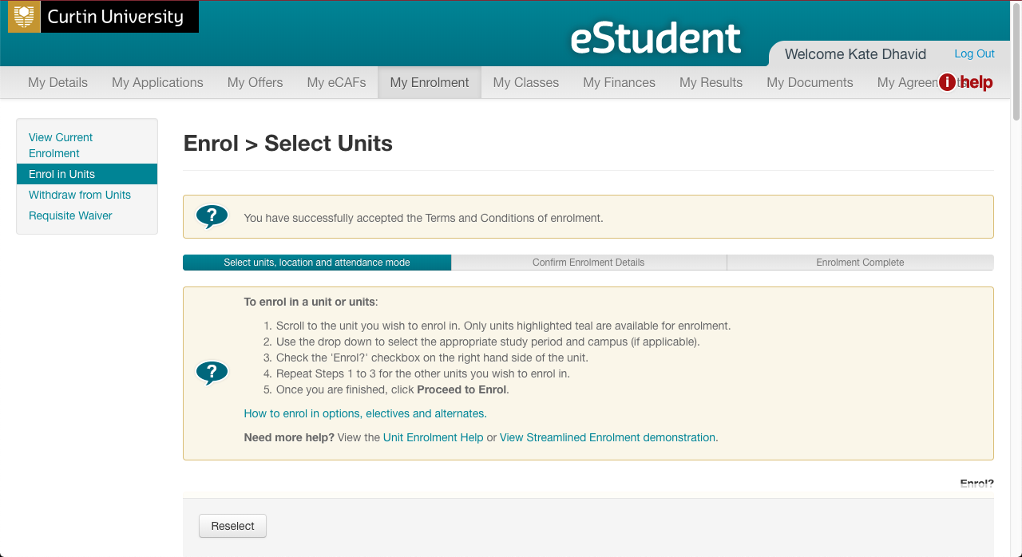
Confirmation of Acceptance

Slide 18
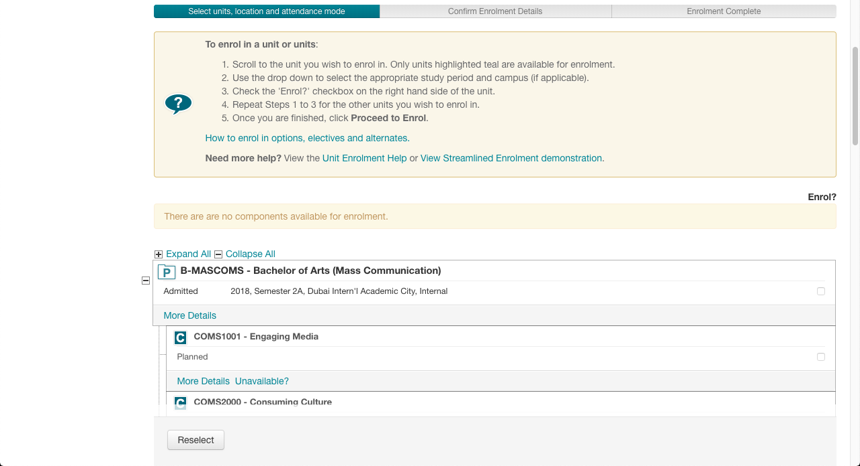
Note: Scroll down to see the units for enrolment.
Only highlighted units (in teal colour) are available for enrolment.
Please read the instructions in the yellow box.

Slide 19
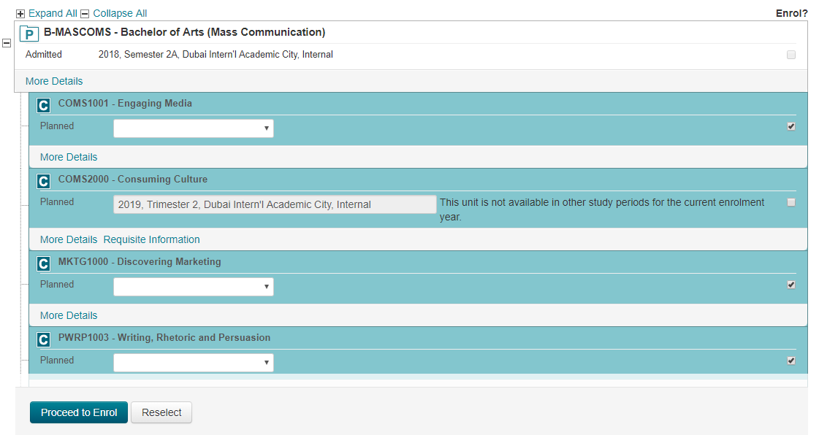
Use the dropdown box of the selected unit, and select
‘2024, Trimester 3, Dubai Intern’l Academic City, Internal’.
Then check on the respective box to enrol.
1. Select the correct availability.
2024, Trimester 3, Dubai Intern’l Academic City, Internal
2. Check the box on the right of the selected unit(s).
3. Repeat steps 1 and 2 for all other units you wish to enrol in. Then click on ‘Proceed to Enrol’.
Notes:
I can’t get this one cos it says course unavailable

Slide 20
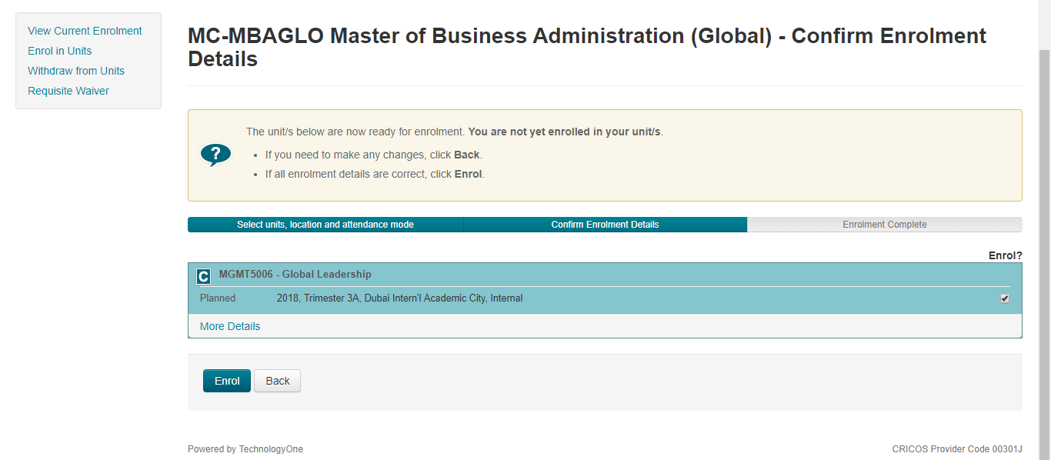
Enrolment Confirmation Details:
Check that the units selected are correct!
Click on ‘Enrol’ to finalise enrolment.
Notes:
Neither can I get this one

Slide 21
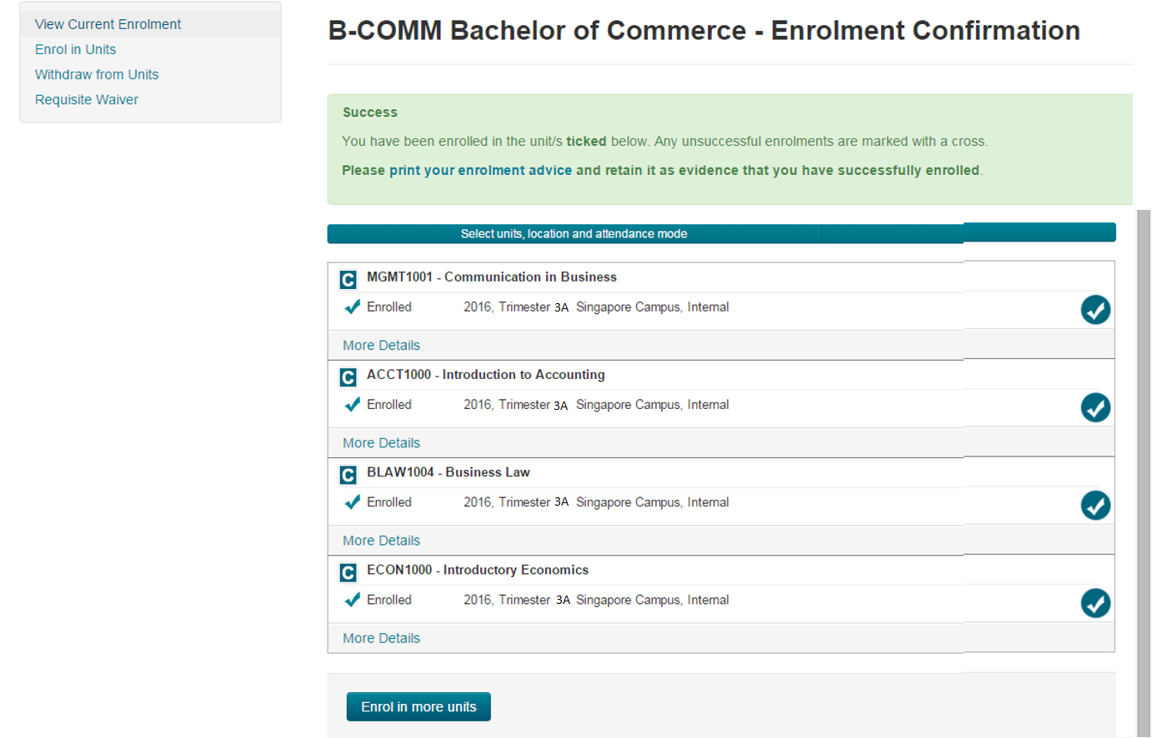
Your Unit Enrolment is now complete!
2018, Semester 2, Singapore Campus, Internal
2018, Semester 2, Singapore Campus, Internal
Click here if you need to ‘Enrol in more units’.
2018, Semester 2, Singapore Campus, Internal
2018, Semester 2, Singapore Campus, Internal
Notes:
Can’t get this one

Slide 22
If you need to retrieve your current enrolment details.
Click on ‘eStudent’

Slide 23
Note: A separate window for eStudent will pop up.
Click on the
‘My Enrolment’ tab.

Slide 24
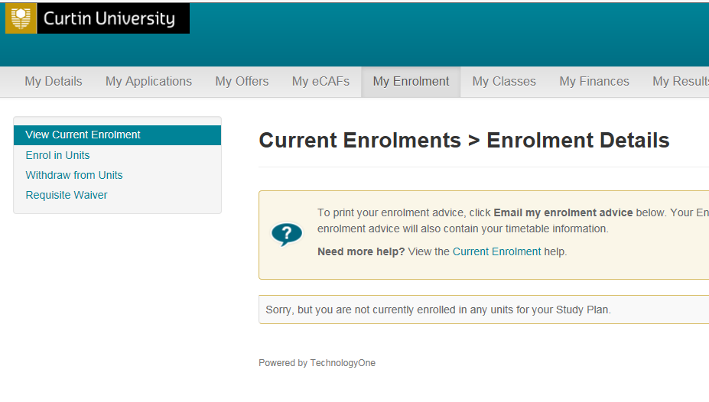
Select ‘View Current Enrolment’
If you face issues with your enrolment in OASIS, please contact Student Service Centre studentservicecentre@curtindubai.ac.ae

