Slide 1
OASIS
Unit Enrolment Guide

Slide 2
Important Notes
Core units – Important units which are part of your degree and should be completed when available
Prerequisites – Units to be completed first before taking a higher-level unit. This can be checked on the handbook http://handbook.curtin.edu.au
Census Dates – These dates are important to understand the withdrawal process.

Slide 3
Census Dates
Start Date | Classes commencement date
Last date to enroll via Estudent | 5 days after commencement date
Census date to withdraw without financial liability | 25 days (3 weeks) after commencement date – Students will not be financially liable in case they withdraw from a unit.
Census date to withdraw without academic penalty | 40 days (10 weeks) after commencement date – Student gets WD on transcript and will be liable to pay full tuition fees for the unit.
Results publication date | Information available on student account

Slide 4

Go to Curtin Dubai’s homepage.
Click on OASIS Login

Slide 5
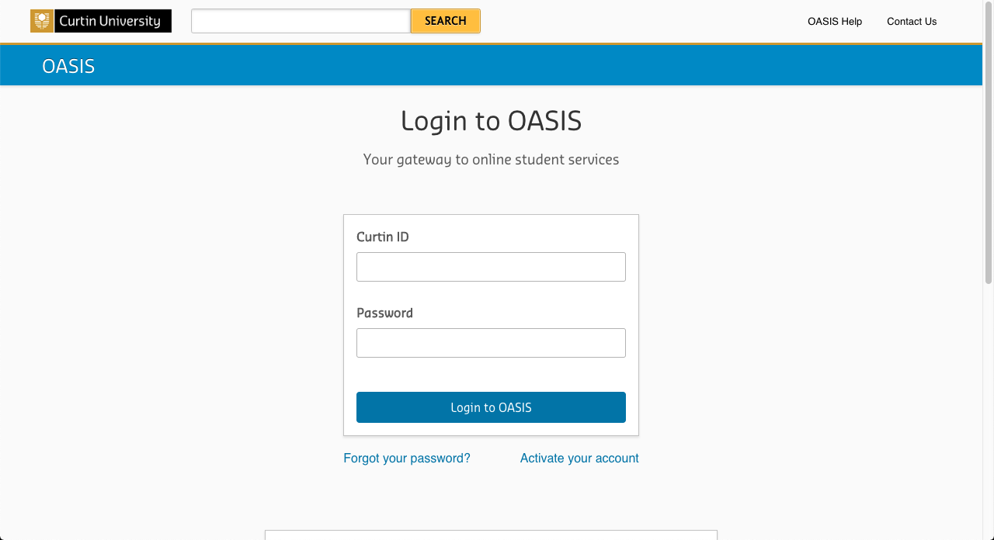
Log in to OASIS.
Available on offer letter

Slide 6
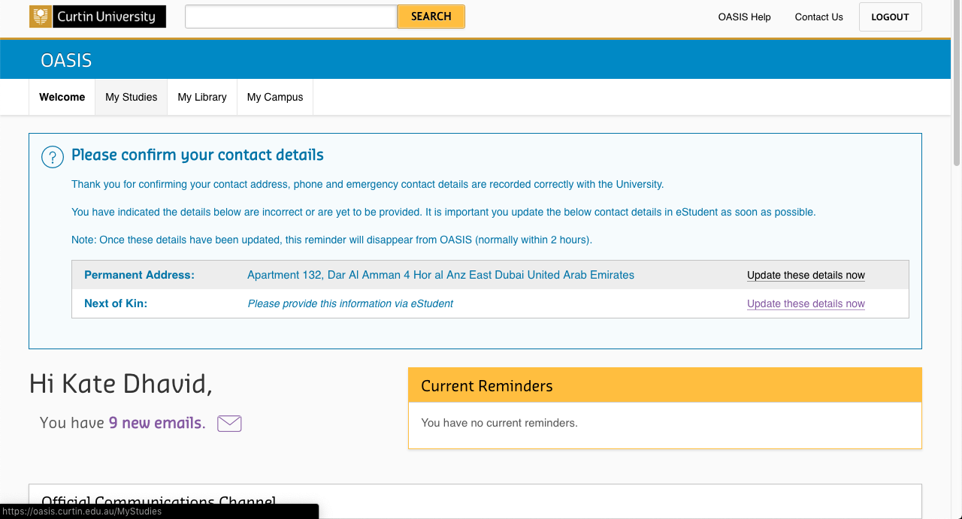
Click on the ‘My Studies’ tab

Slide 7
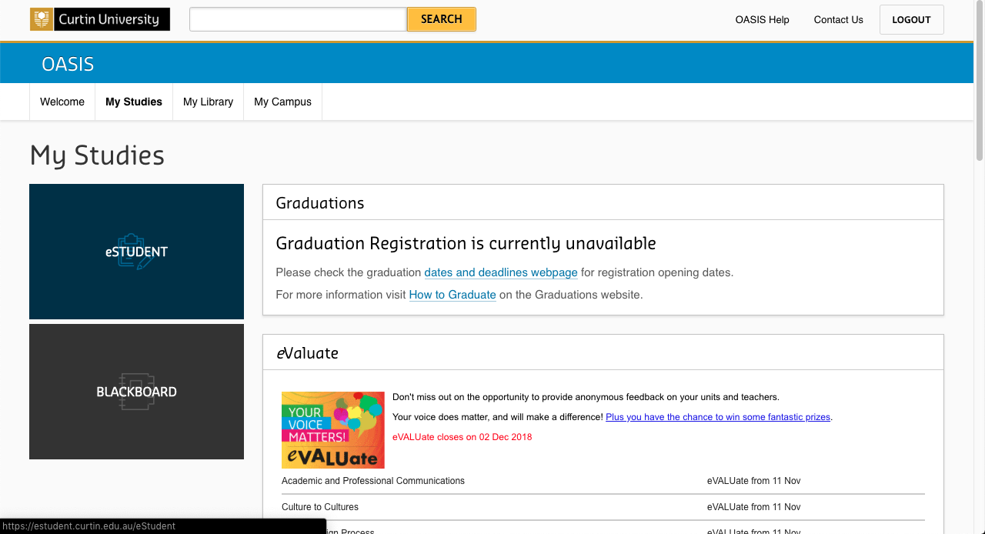
Click on ‘eStudent’

Slide 8
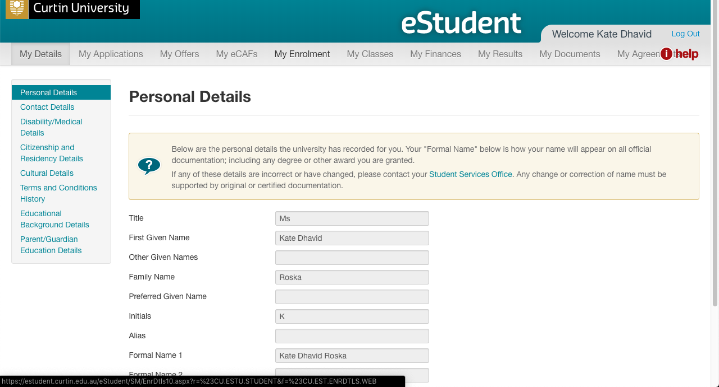
Note: A separate window for eStudent will pop up.
Click on the
‘My Enrolment’ tab.

Slide 9
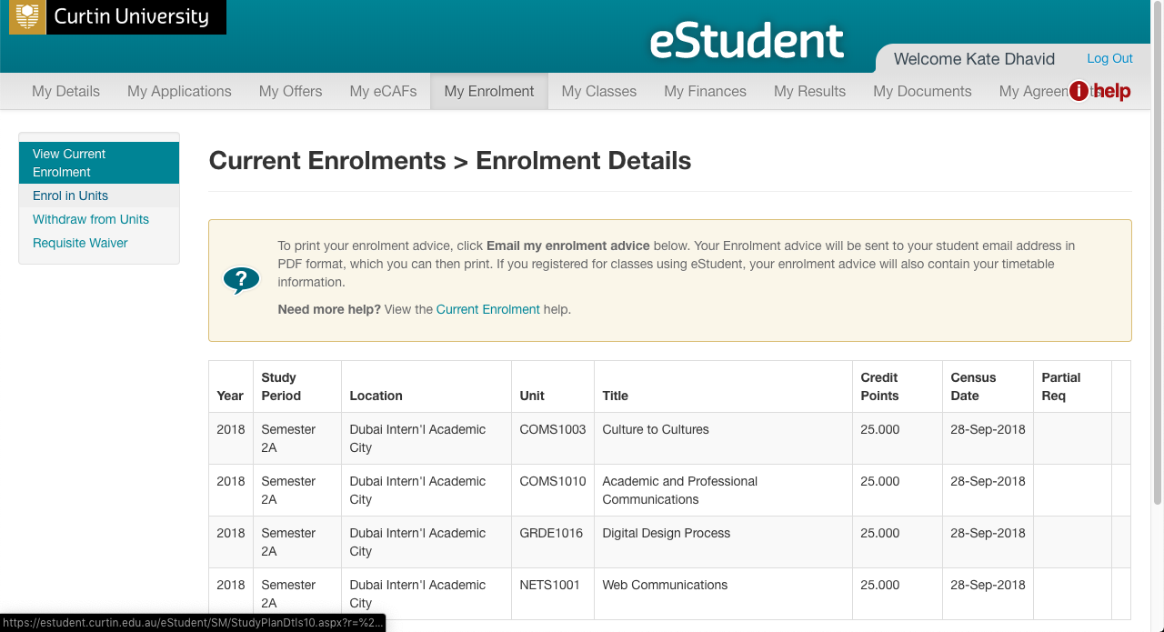
Click on
‘Enrol in Units’

Slide 10
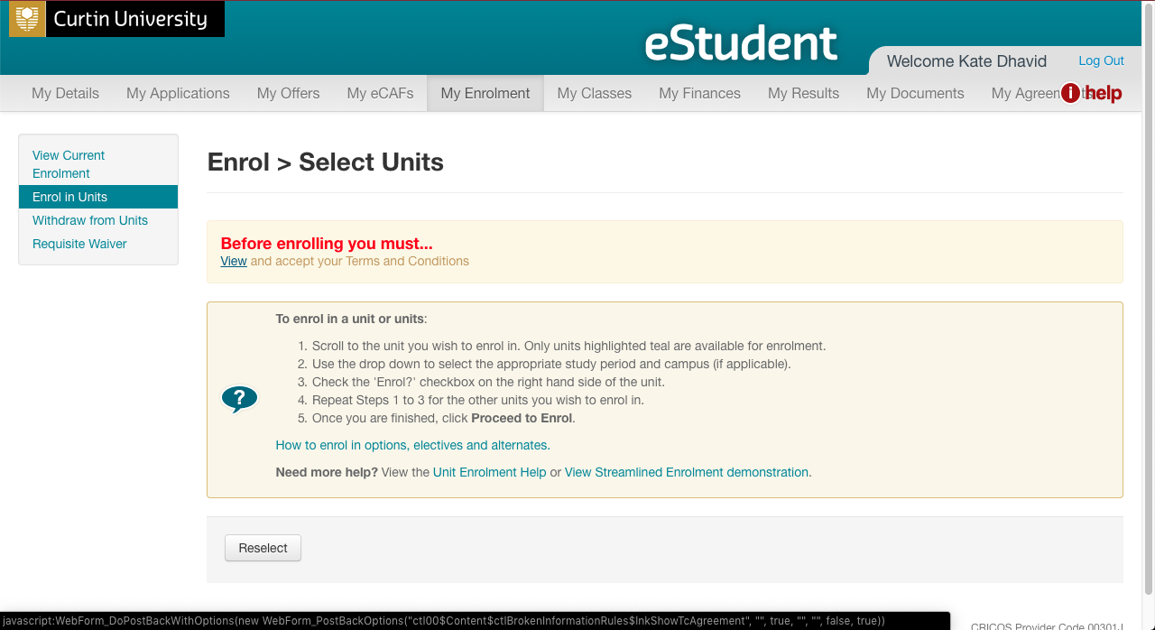
Warning message will appear for first-time users.
Click on ‘View’ to view the Institution Terms and Conditions’

Slide 11
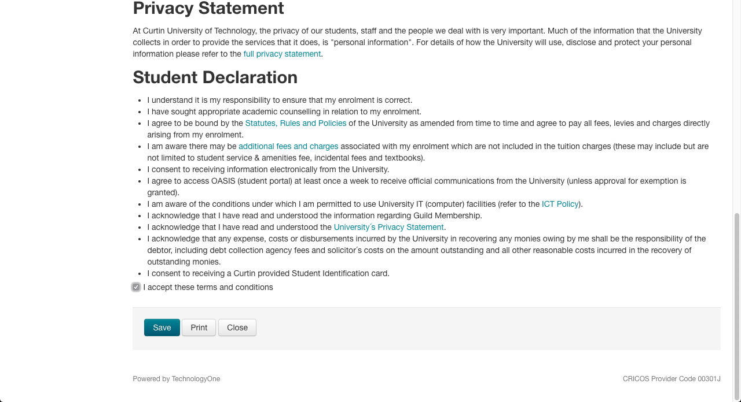
Institution Terms and Conditions
Please read and check ‘I accept these terms and conditions’.
Then click on ‘Save’.

Slide 12
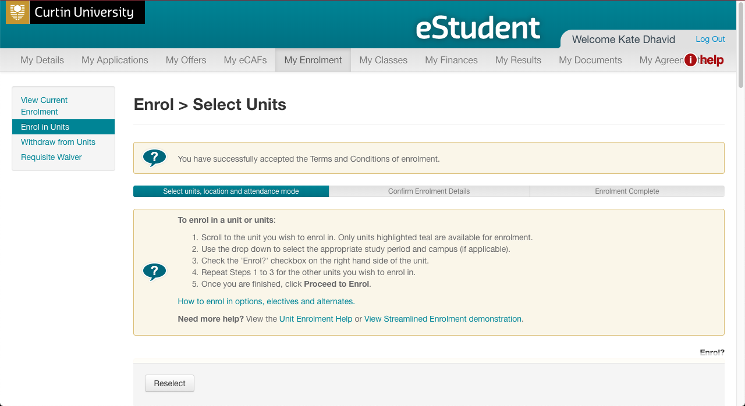
Confirmation of Acceptance

Slide 13
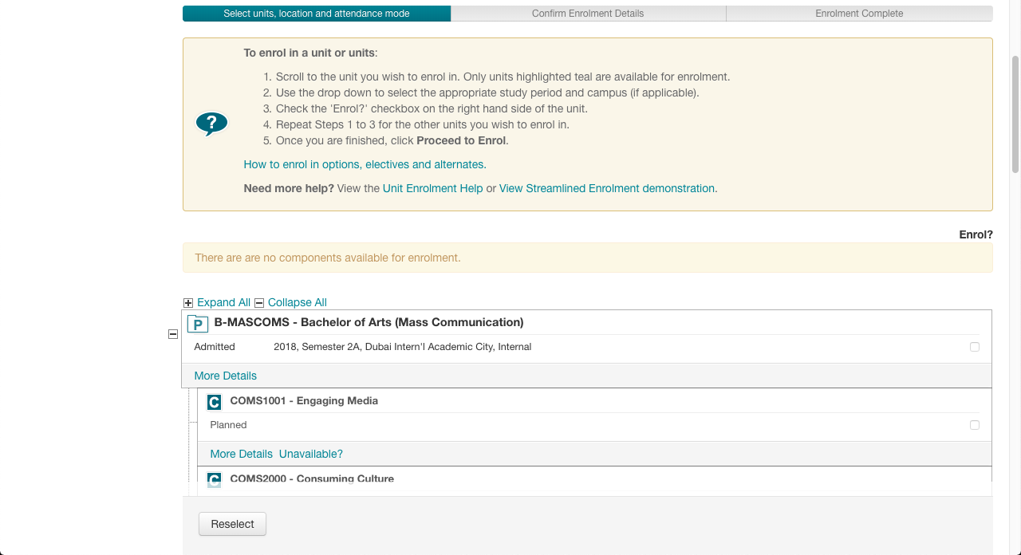
Note: Scroll down to see the units for enrolment.
Only highlighted units (in teal colour) are available for enrolment.
Please read the instructions in the yellow box.

Slide 14
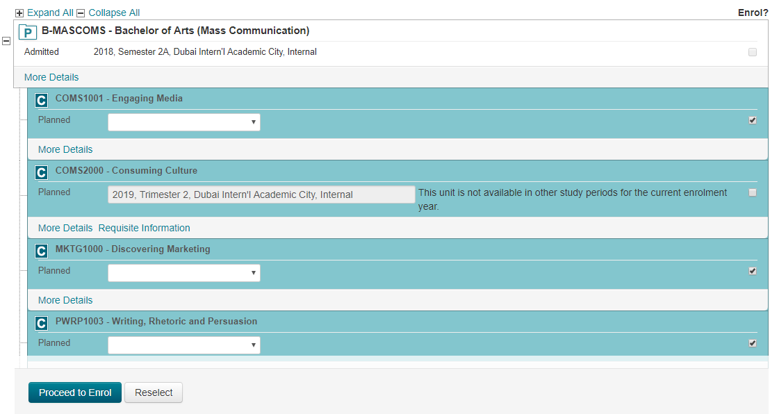
Use the drop down box of the selected unit, and select
‘2025,Trimester 1A, Dubai Intern’l Academic City, Internal’.
Then check on the respective box to enrol.
1. Select the correct availability.
2025,Trimester 1A, Dubai Intern’l Academic City, Internal
2. Check the box on the right of the selected unit(s).
3. Repeat steps 1 and 2 for all other units you wish to enrol in. Then click on ‘Proceed to Enrol’.
Notes:
I can’t get this one cos it says course unavailable

Slide 15
Units to Enrol
MBA | MEM
FNCE5008_Financial Principles and Analysis | CSEN6000_Engineering Contracts, Legislation and Quality
ECOM5005_Business Analytics and Data Visualization | CSEN6001_Engineering Economics and Whole-Cost Management
ECON5012_Global Managerial Economics | CSEN6003_Engineering Quality Assurance Frameworks and Applications
MGMT5003_Culture and Ethics in Global Business

Slide 16
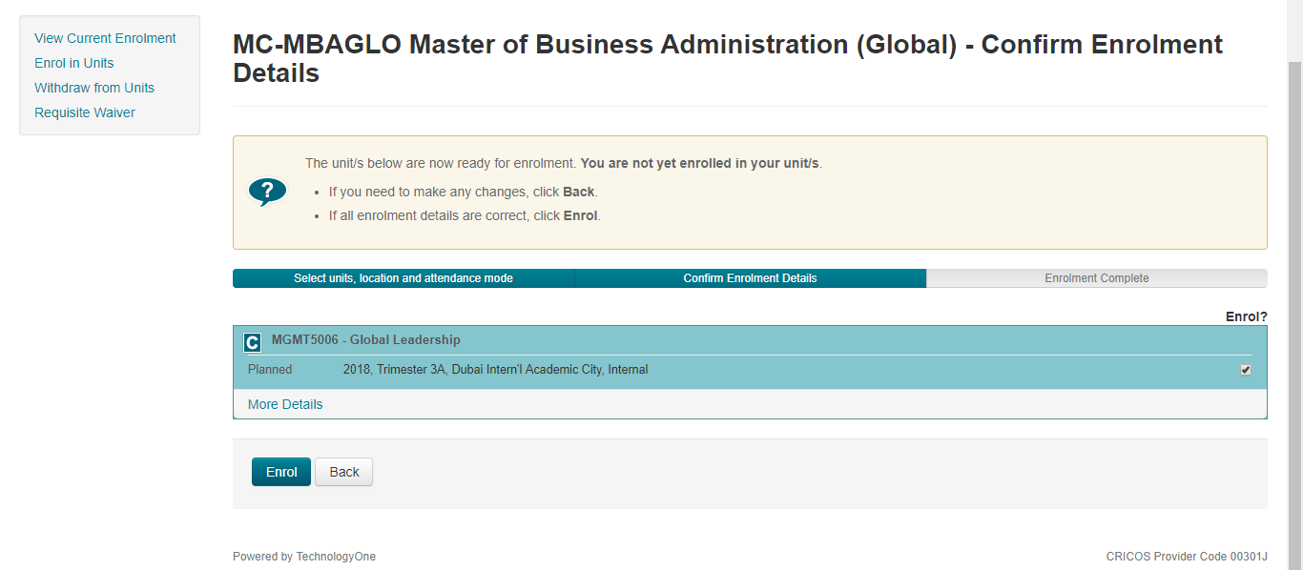
Enrolment Confirmation Details:
Check that the units selected are correct!
Click on ‘Enrol’ to finalise enrolment.
Notes:
Neither can I get this one

Slide 17
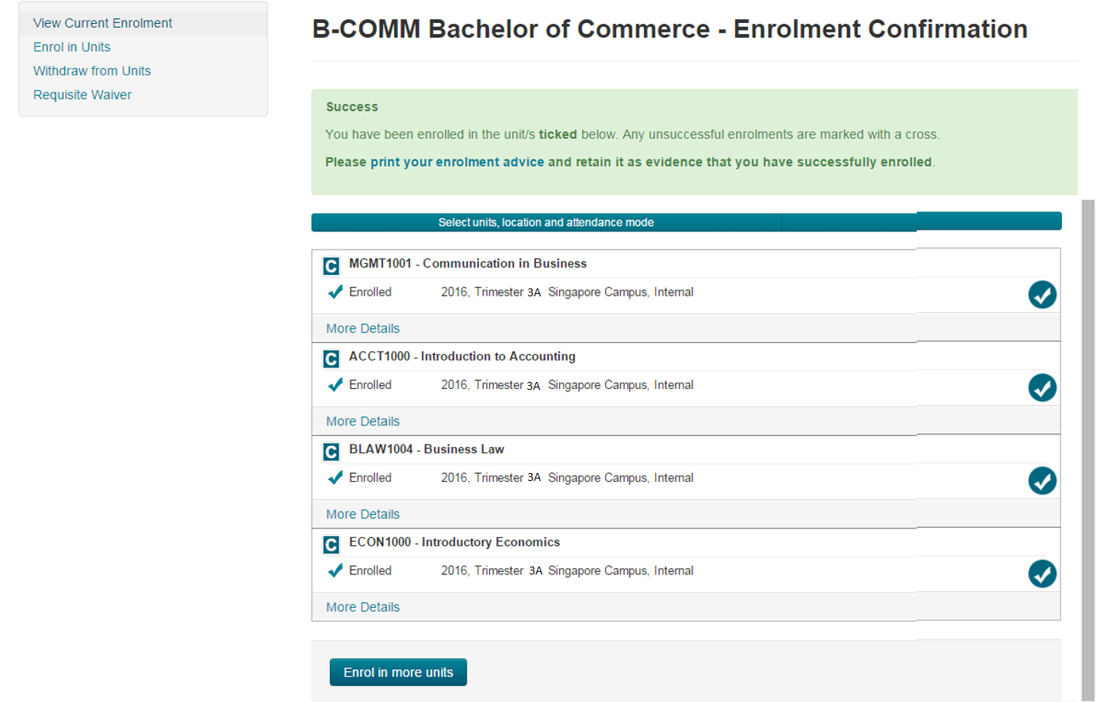
Your Unit Enrolment is now complete!
2018, Semester 2, Singapore Campus, Internal
2018, Semester 2, Singapore Campus, Internal
Click here if you need to ‘Enrol in more units’.
2018, Semester 2, Singapore Campus, Internal
2018, Semester 2, Singapore Campus, Internal
Notes:
Can’t get this one

Slide 18
If you need to retrieve your current enrolment details.
Click on ‘eStudent’

Slide 19
Note: A separate window for eStudent will pop up.
Click on the
‘My Enrolment’ tab.

Slide 20
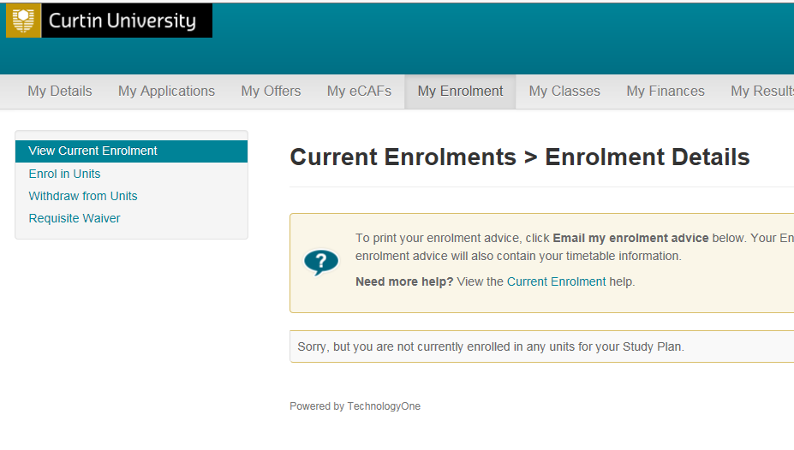
Select ‘View Current Enrolment’
If you face issues with your enrolment in OASIS, please contact Student Service Centre studentservicecentre@curtindubai.ac.ae

